Slide 1
Multivariate Associative Techniques
Bratislav Misic
McConnell Brain Imaging Centre
Montréal Neurological Institute
McGill University

Slide 2
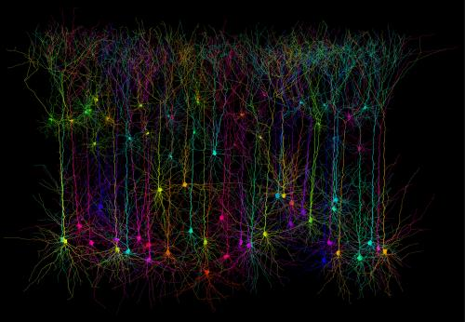
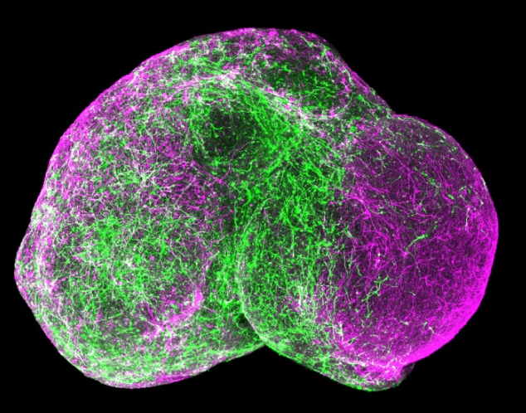
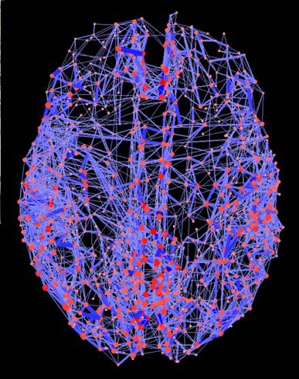

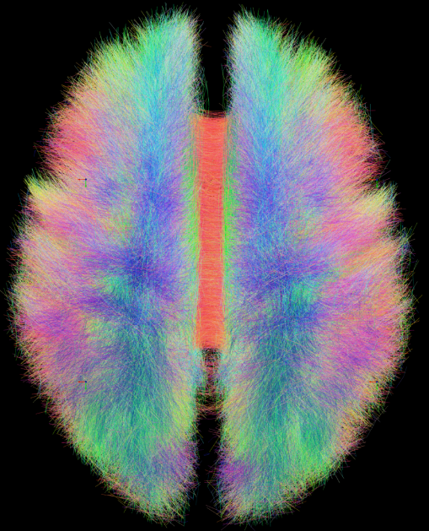
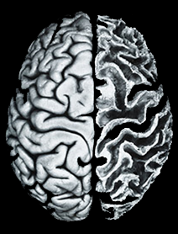
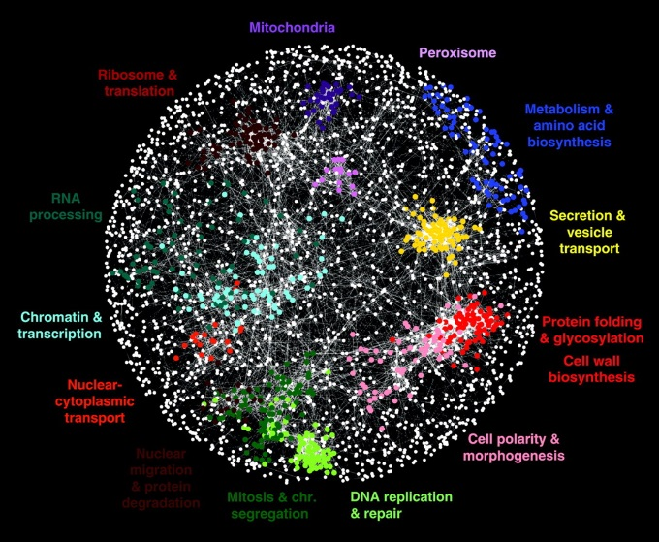
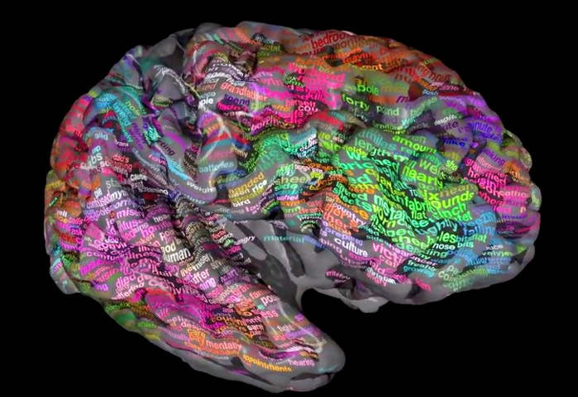
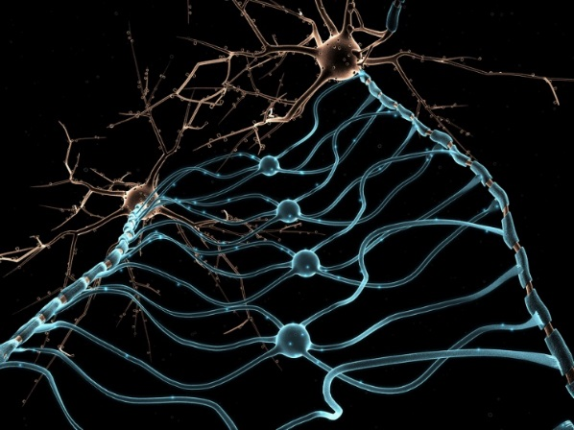
connectome

Slide 3
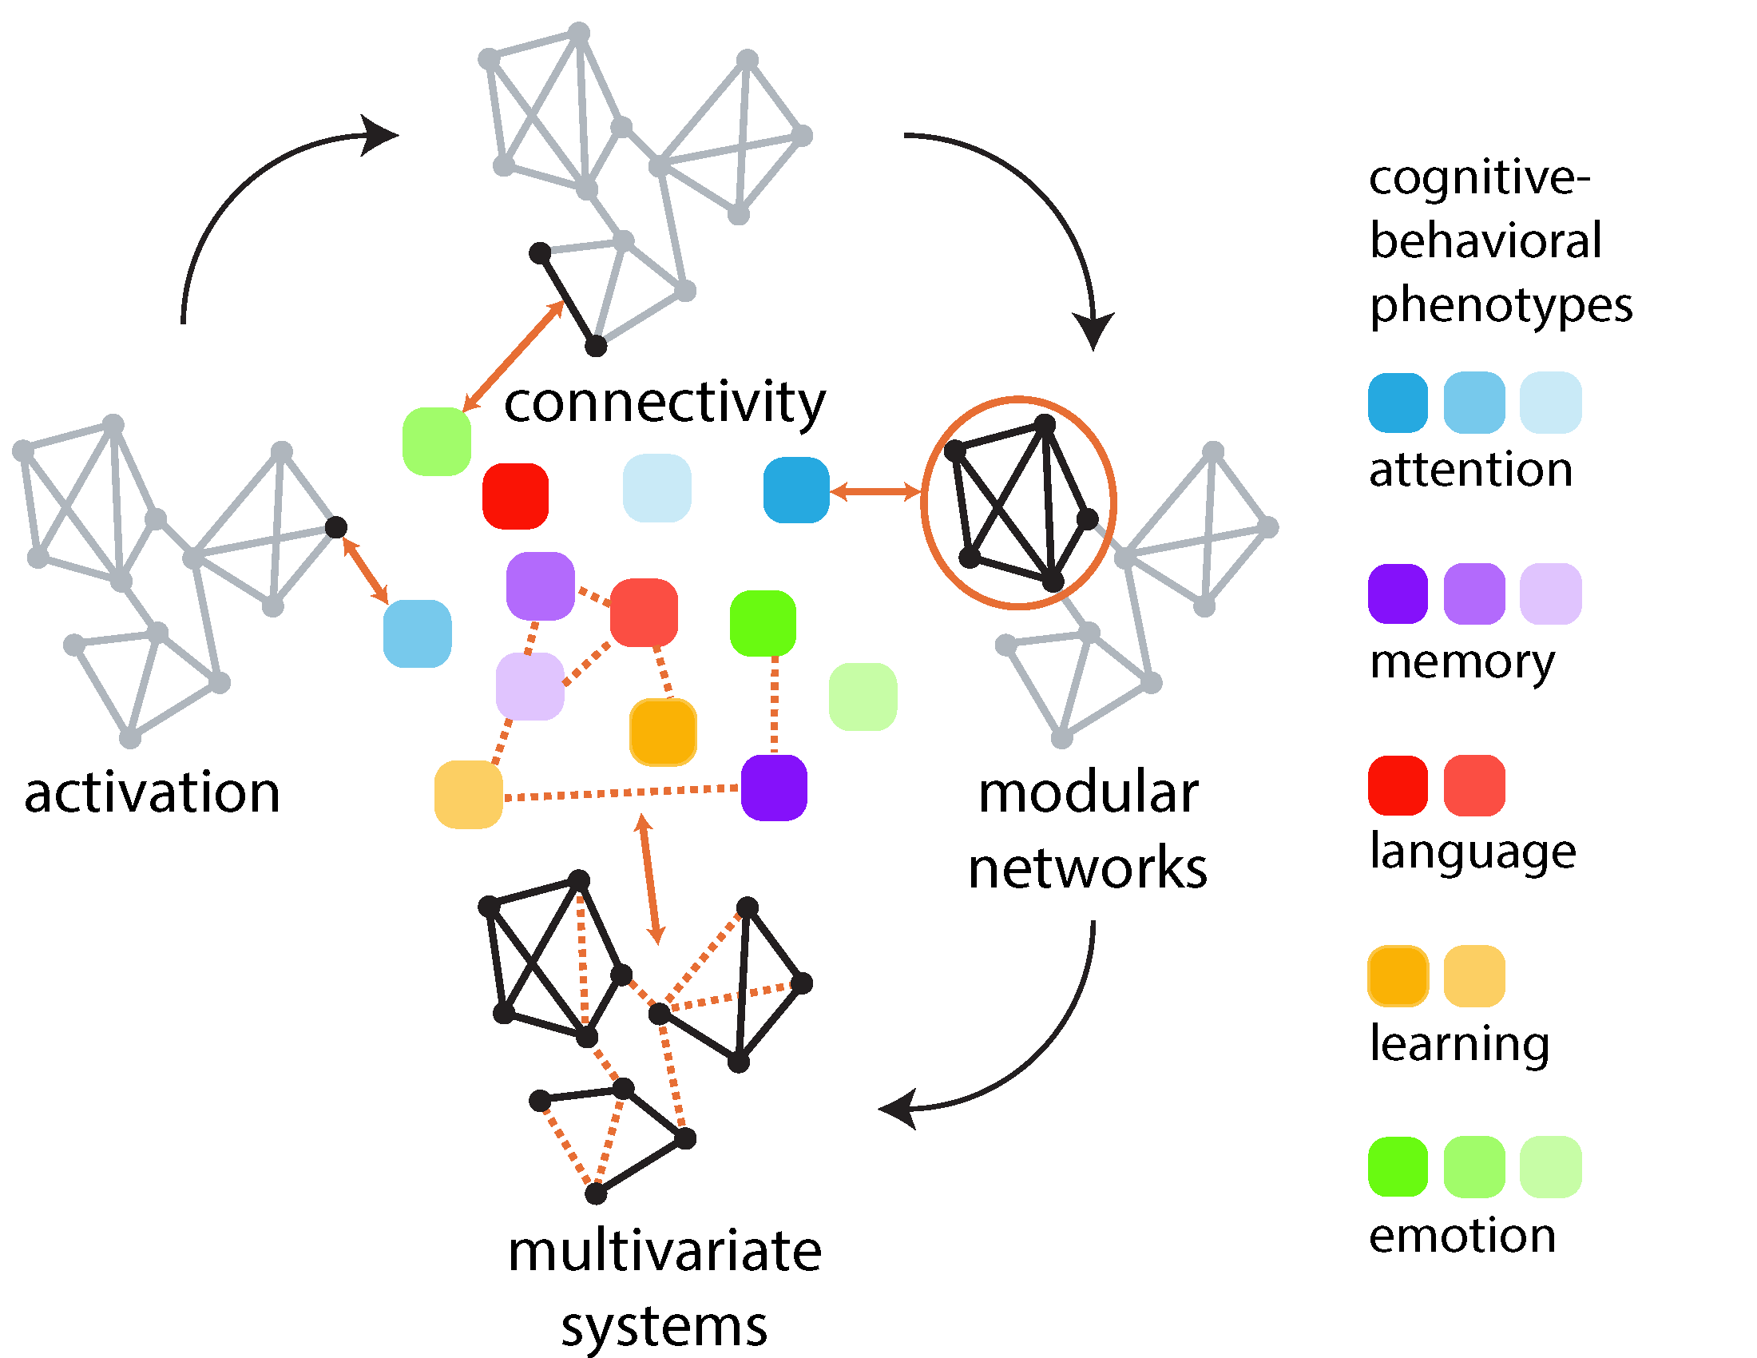
Towards multivariate analysis
activation: mapping individual elements to individual external variables
connectivity: mapping individual structural or functional connections to individual external variables
networks: mapping network attributes to individual external variables
multivariate systems: mapping patterns of elements or connections to patterns of external variables
Misic & Sporns (2016) Curr Opin Neurobiol

Slide 4
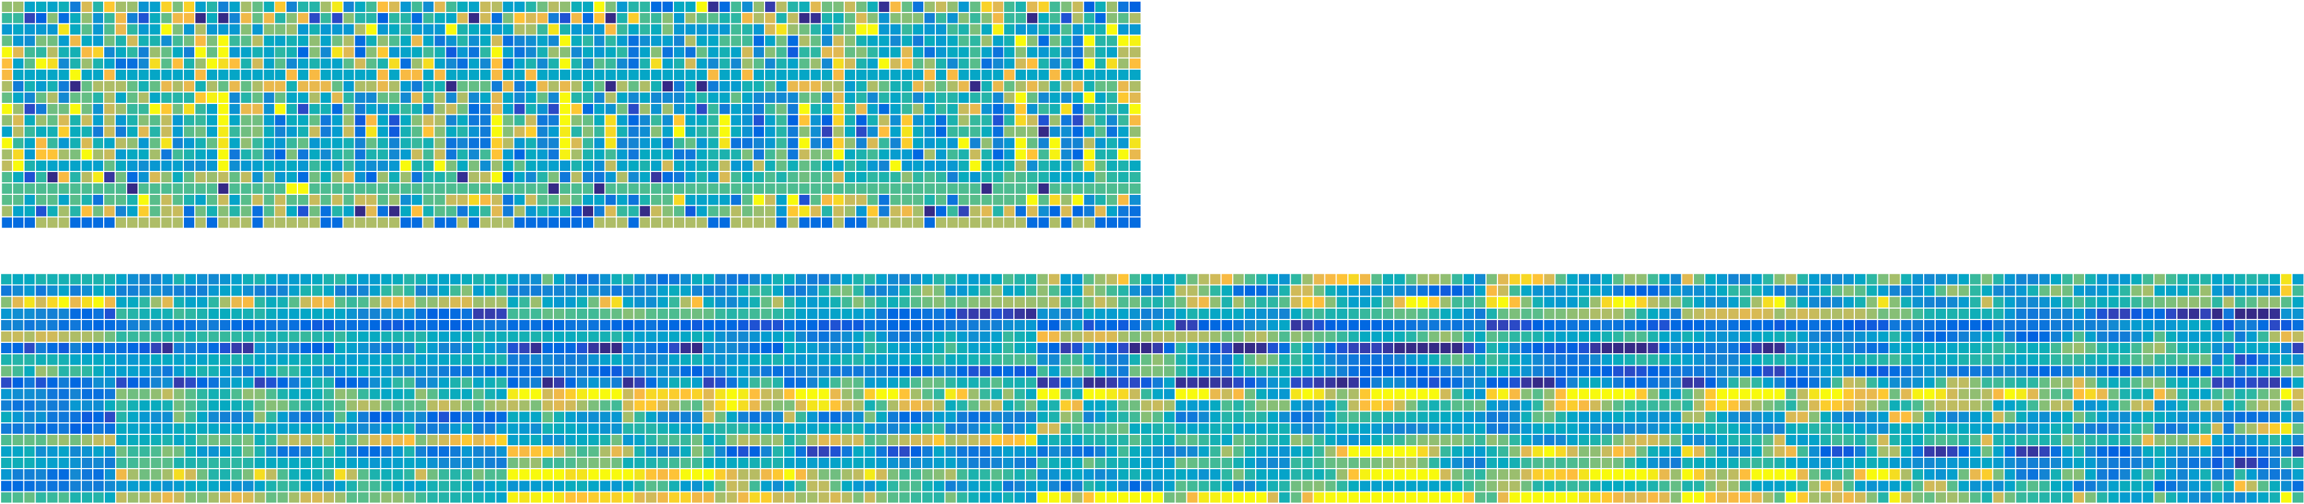
Integrating scales and modalities
variables
observations
variables
+
observations
How to deal with more variables than observations?
How to operationalize the network property?
How to relate multiple data sets to each other?

Slide 5
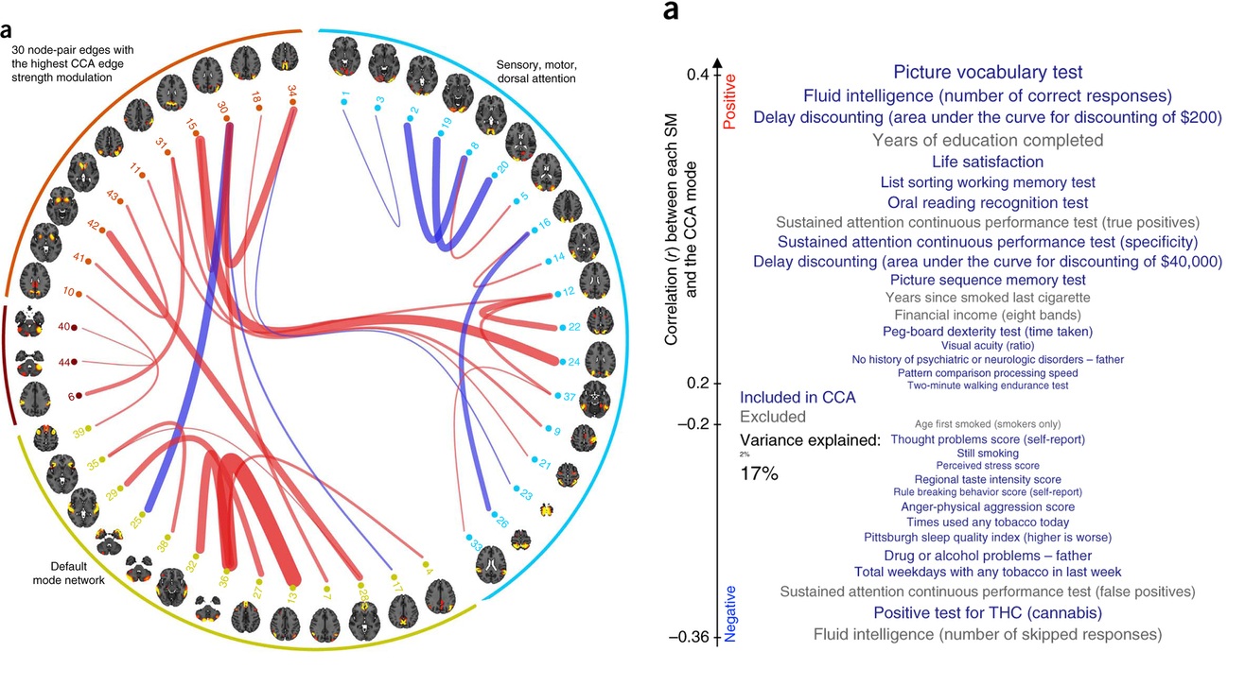
Example: relating connectivity and behaviour
dataset: Human Connectome Project (HCP); n=900 individuals
modality #1 : resting state functional connectivity
modality #2: comprehensive behavioural + demographics battery
question: how do individual differences in functional interactions map onto behaviour?
analysis: Canonical Correlation (CCA)
Smith et al. (2016) Nat Neurosci

Slide 6
Lecture plan
Goal #1: associative multivariate models are useful and versatile
Goal #2: these techniques are mathematically related
Goal #3: nonparametric statistical inference can be easily applied
Goal #4: examples + demo

Slide 7
A family of techniques
voxels / sensors / nodes / connections
X
observations
behaviour / genetics / other imaging
Y
observations
principal component analysis (PCA): SVD(X)
partial least-squares (PLS): SVD(X’Y)
canonical correlation analysis (CCA): SVD((X’X)^{-1/2}(X’Y)(Y’Y)^{-1/2})
linear discriminant analysis (LDA): SVD(W⁻¹B)
Eckart & Young (1936) Psychometrika
De Bie (2005) Handbook Geom Comput
McIntosh & Misic (2013) Annu Rev Psychol
Worsley et al. (1997) NeuroImage

Slide 8
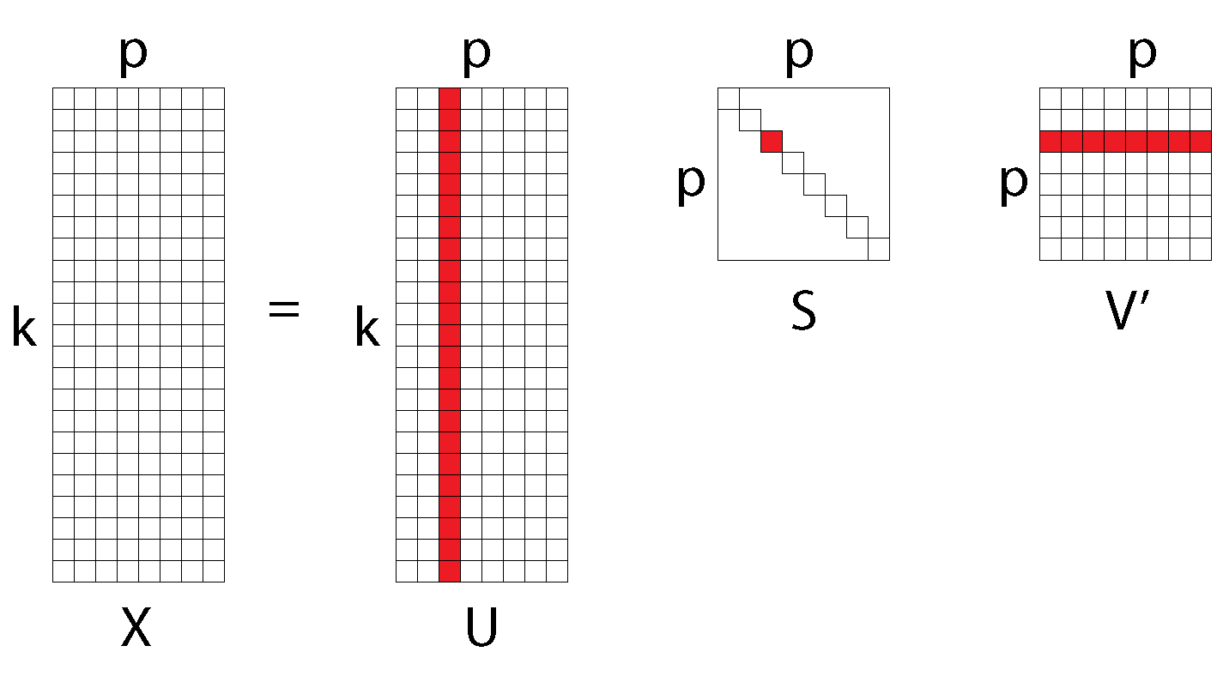
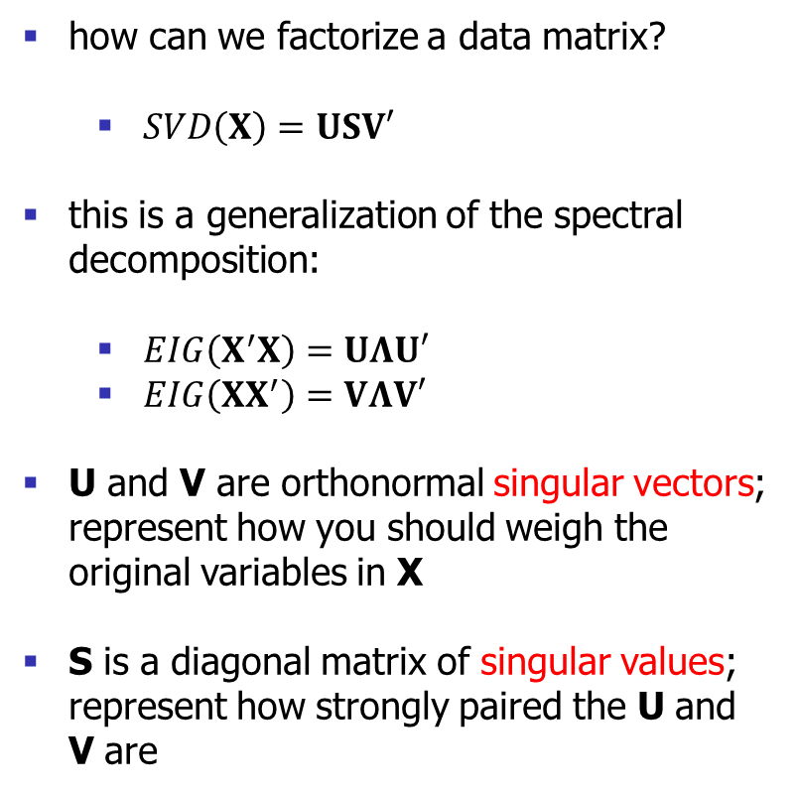
Singular value decomposition (SVD)
how can we factorize a data matrix?
$SVD\left(X\right)=USV′$
this is a generalization of the spectral decomposition:
$EIG\left(X^{′}X\right)=UΛU′$
$EIG\left(XX^{′}\right)=VΛV′$
U and V are orthonormal singular vectors; represent how you should weigh the original variables in X
S is a diagonal matrix of singular values; represent how strongly paired the U and V are
Eckart & Young (1936) Psychometrika

Slide 9
Principal component analysis (PCA)
original variables x₁ and x₂ are correlated but neither captures the dominant pattern of variance
want a new variables z₁ and z₂ that (a) capture as much variance (b) are mutually uncorrelated
need to find a rotation u to re-align the original axes (variables)
u is chosen to maximize the variance of the new variables z
Hotelling (1933) J Educ Psychol

Slide 10
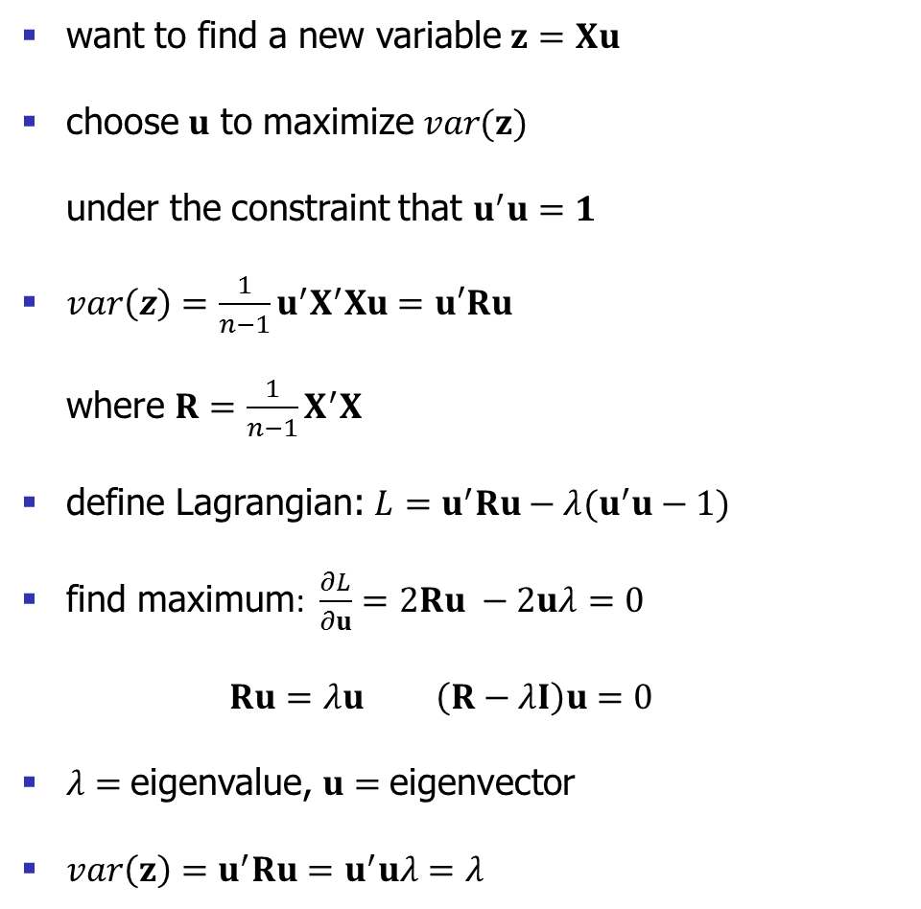
Maximzing variance
want to find a new variable $z=Xu$
choose $u$ to maximize $var(z)$ under the constraint that $u^{′}u=1$
$var\left(z\right)=\frac{1}{n−1}u^{′}X^{′}Xu=u′Ru$ where $R=\frac{1}{n−1}X^{′}X$
define Lagrangian: $L=u^{′}Ru−λ(u^{′}u−1)$
find maximum: $\frac{∂L}{∂u}=2Ru −2uλ=0$ $Ru=λu \left(R−λI\right)u=0$
$λ=$eigenvalue, $u=$eigenvector
$var\left(z\right)=u^{′}Ru=u^{′}uλ=λ$
Hotelling (1933) J Educ Psychol

Slide 11
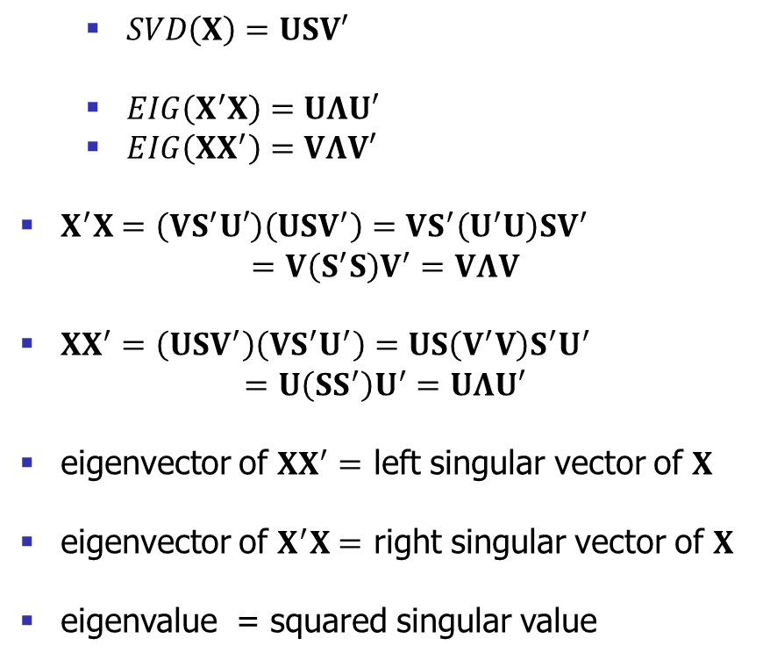
Singular value decomposition (SVD)
$SVD\left(X\right)=USV′$
$EIG\left(X^{′}X\right)=UΛU′$
$EIG\left(XX^{′}\right)=VΛV′$
$X^{′}X=\left(VS^{′}U′\right)\left(USV^{′}\right)=VS^{′}\left(U^{′}U\right)SV^{′}$ $=V\left(S^{′}S\right)V^{′}=VΛV$
$XX^{′}=\left(USV^{′}\right)\left(VS^{′}U^{′}\right)=US\left(V^{′}V\right)S^{′}U^{′}$ $=U\left(SS^{′}\right)U^{′}=UΛU′$
eigenvector of $XX^{′}=$ left singular vector of $X$
eigenvector of $X^{′}X=$ right singular vector of $X$
eigenvalue = squared singular value
Eckart & Young (1936) Psychometrika

Slide 12
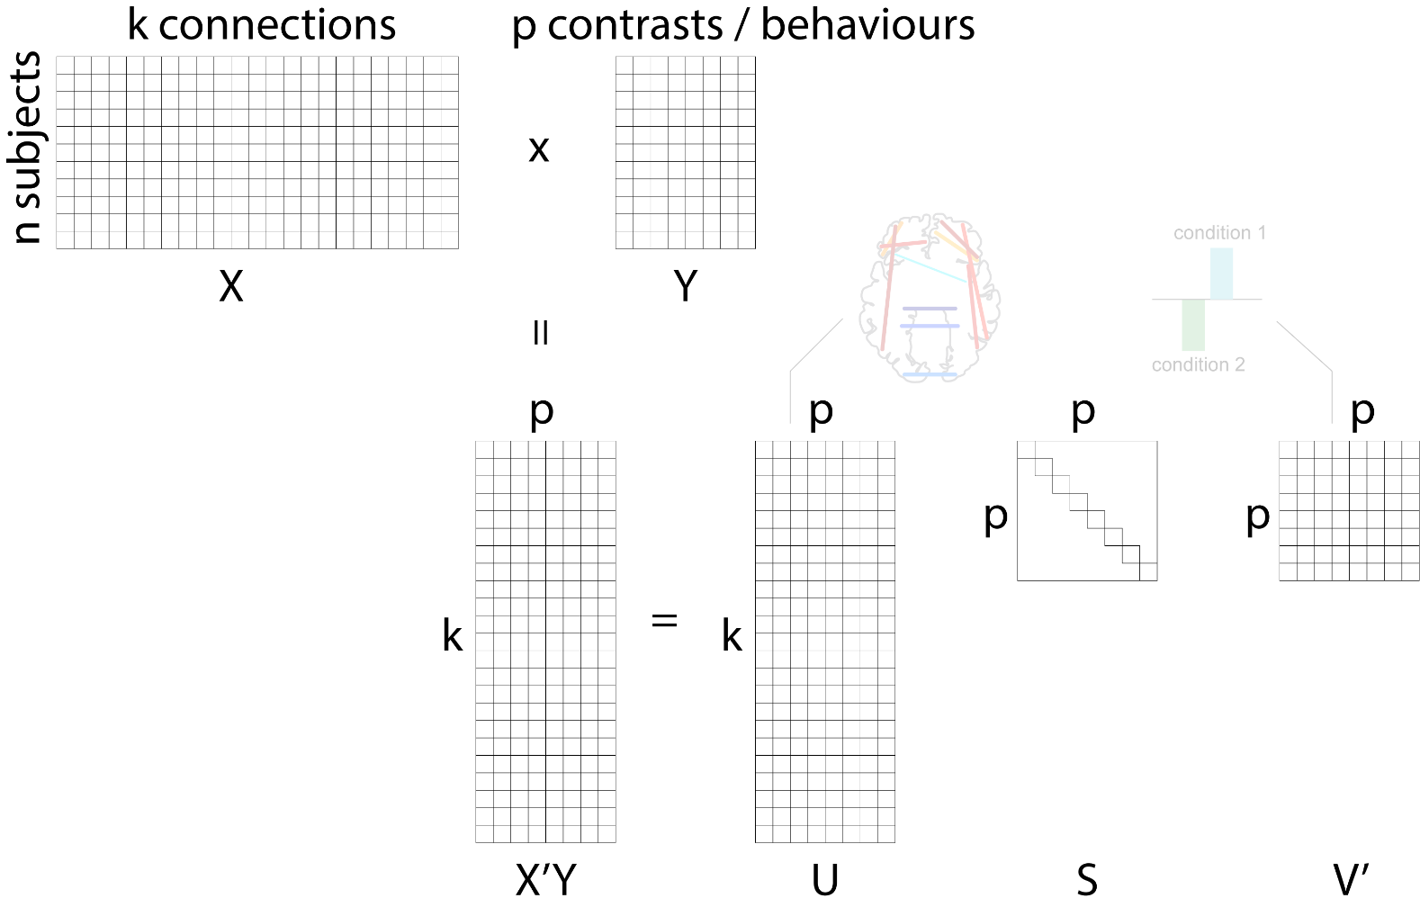
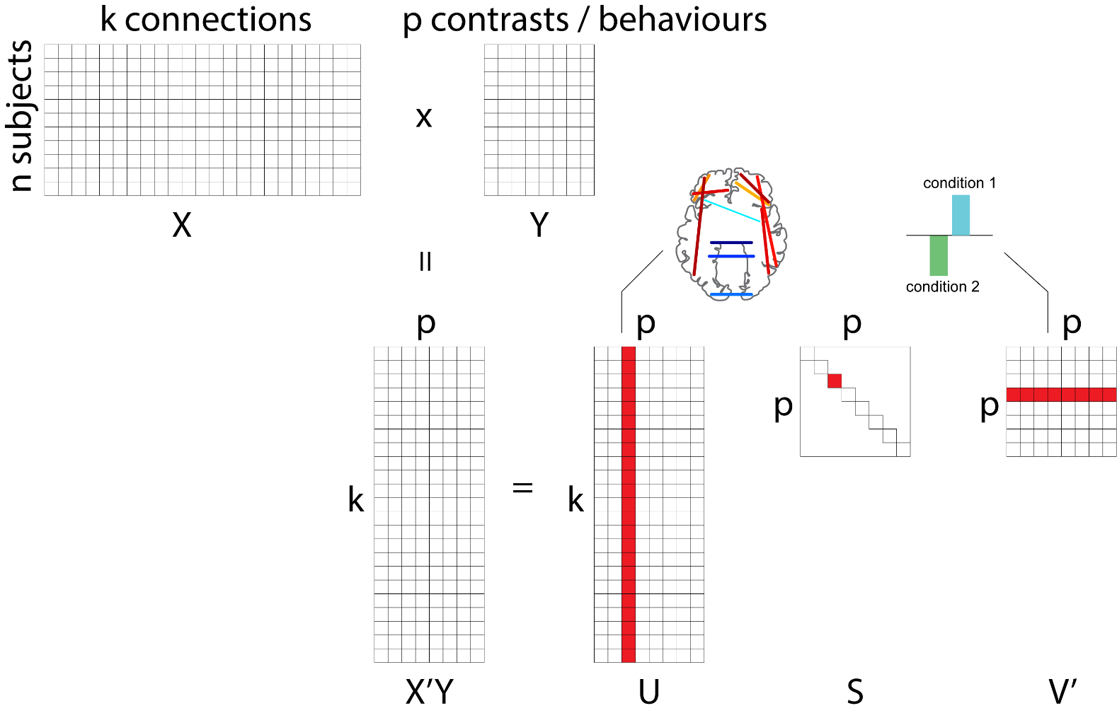
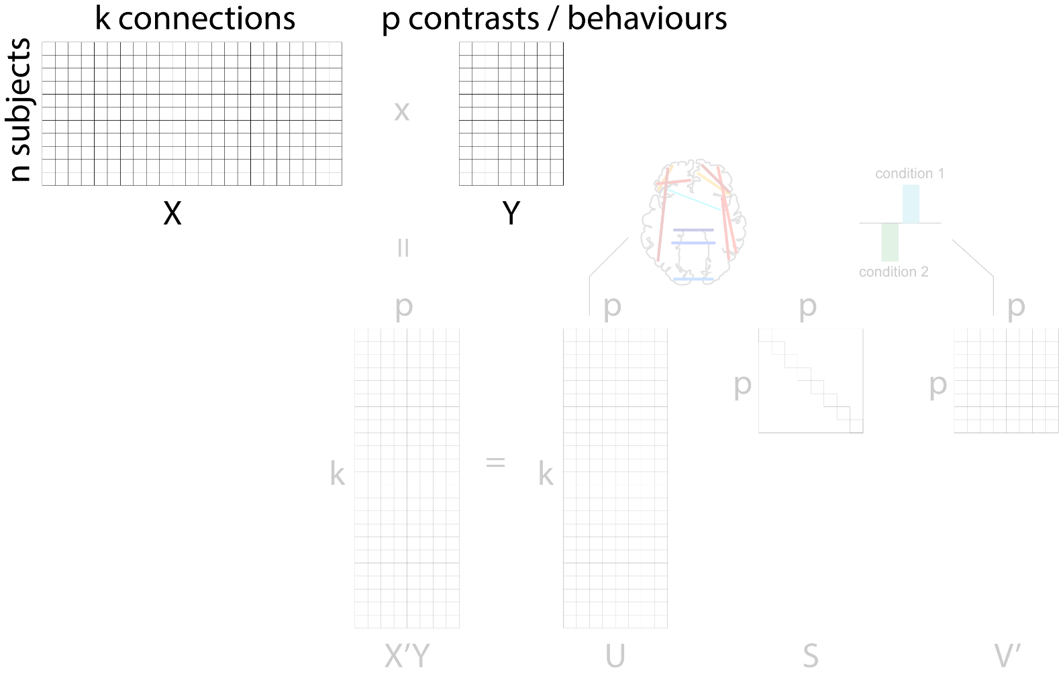
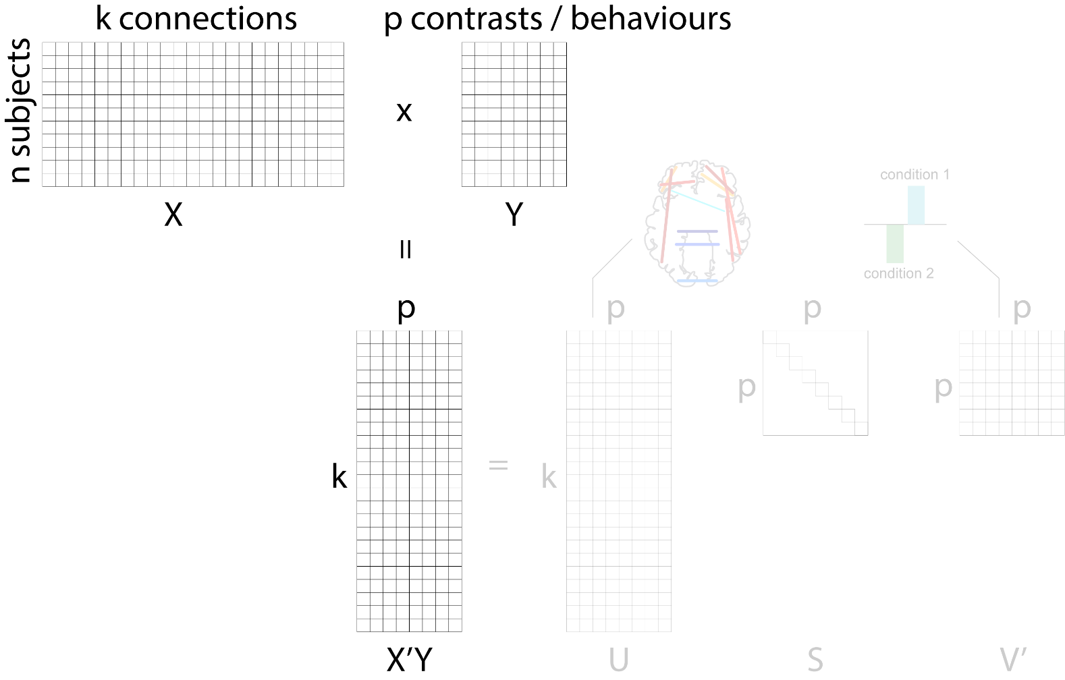
Partial least squares
in PCA, you decompose the original data matrix X
in PLS, you decompose a correlation matrix (X’Y) between two data matrices X and Y
get multiple latent variables (aka components, modes, variates)
singular vectors represent the optimal weighing of original variables, e.g. patterns of connectivity + patterns of behaviour
singular value represents the proportion of X-Y covariance accounted for by the pairing
Wold et al. (1982; 1984) Math Stat Chem

Slide 13
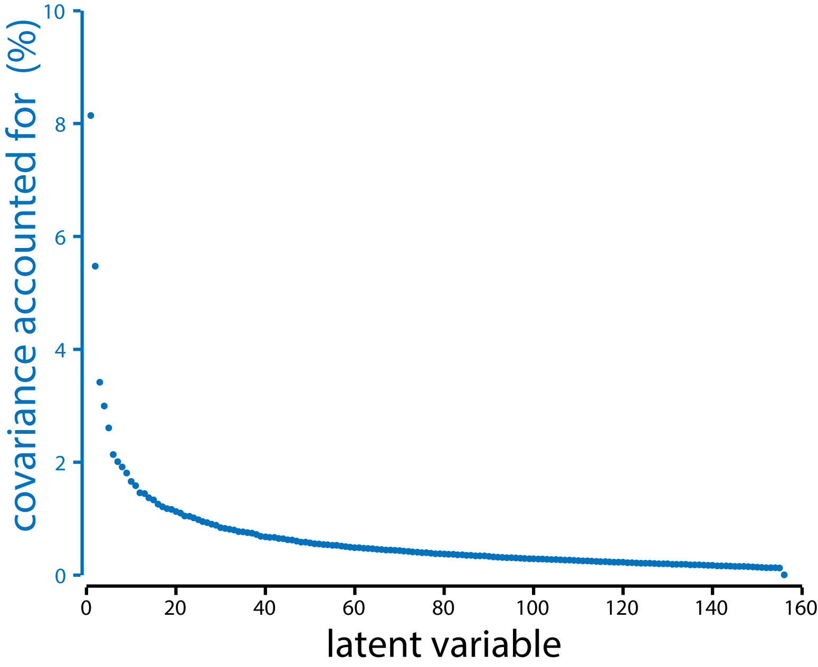
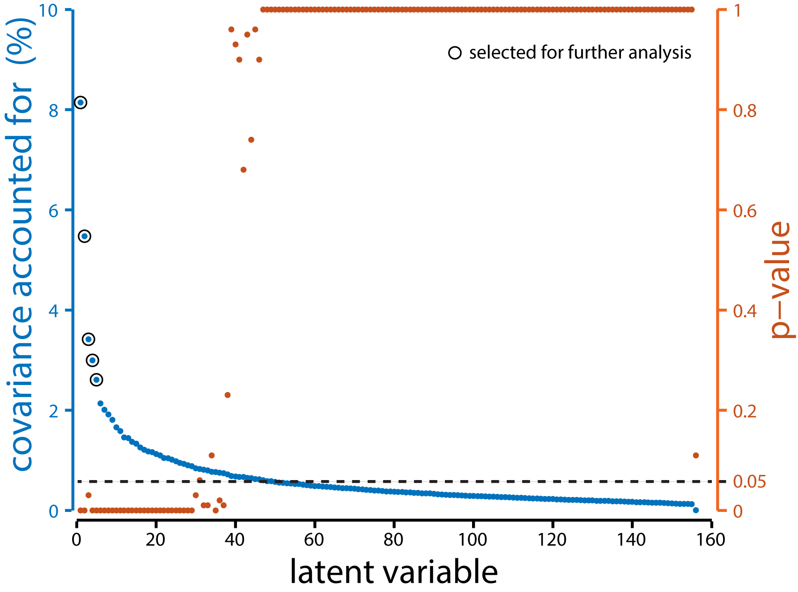
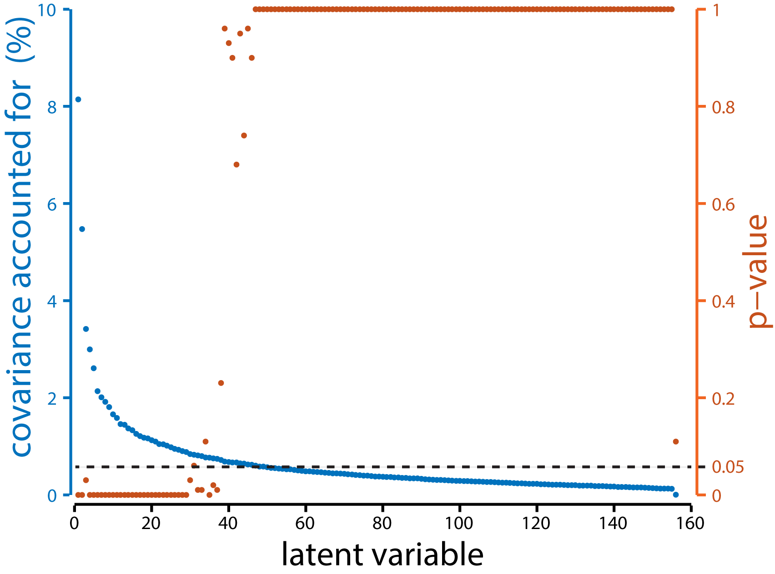
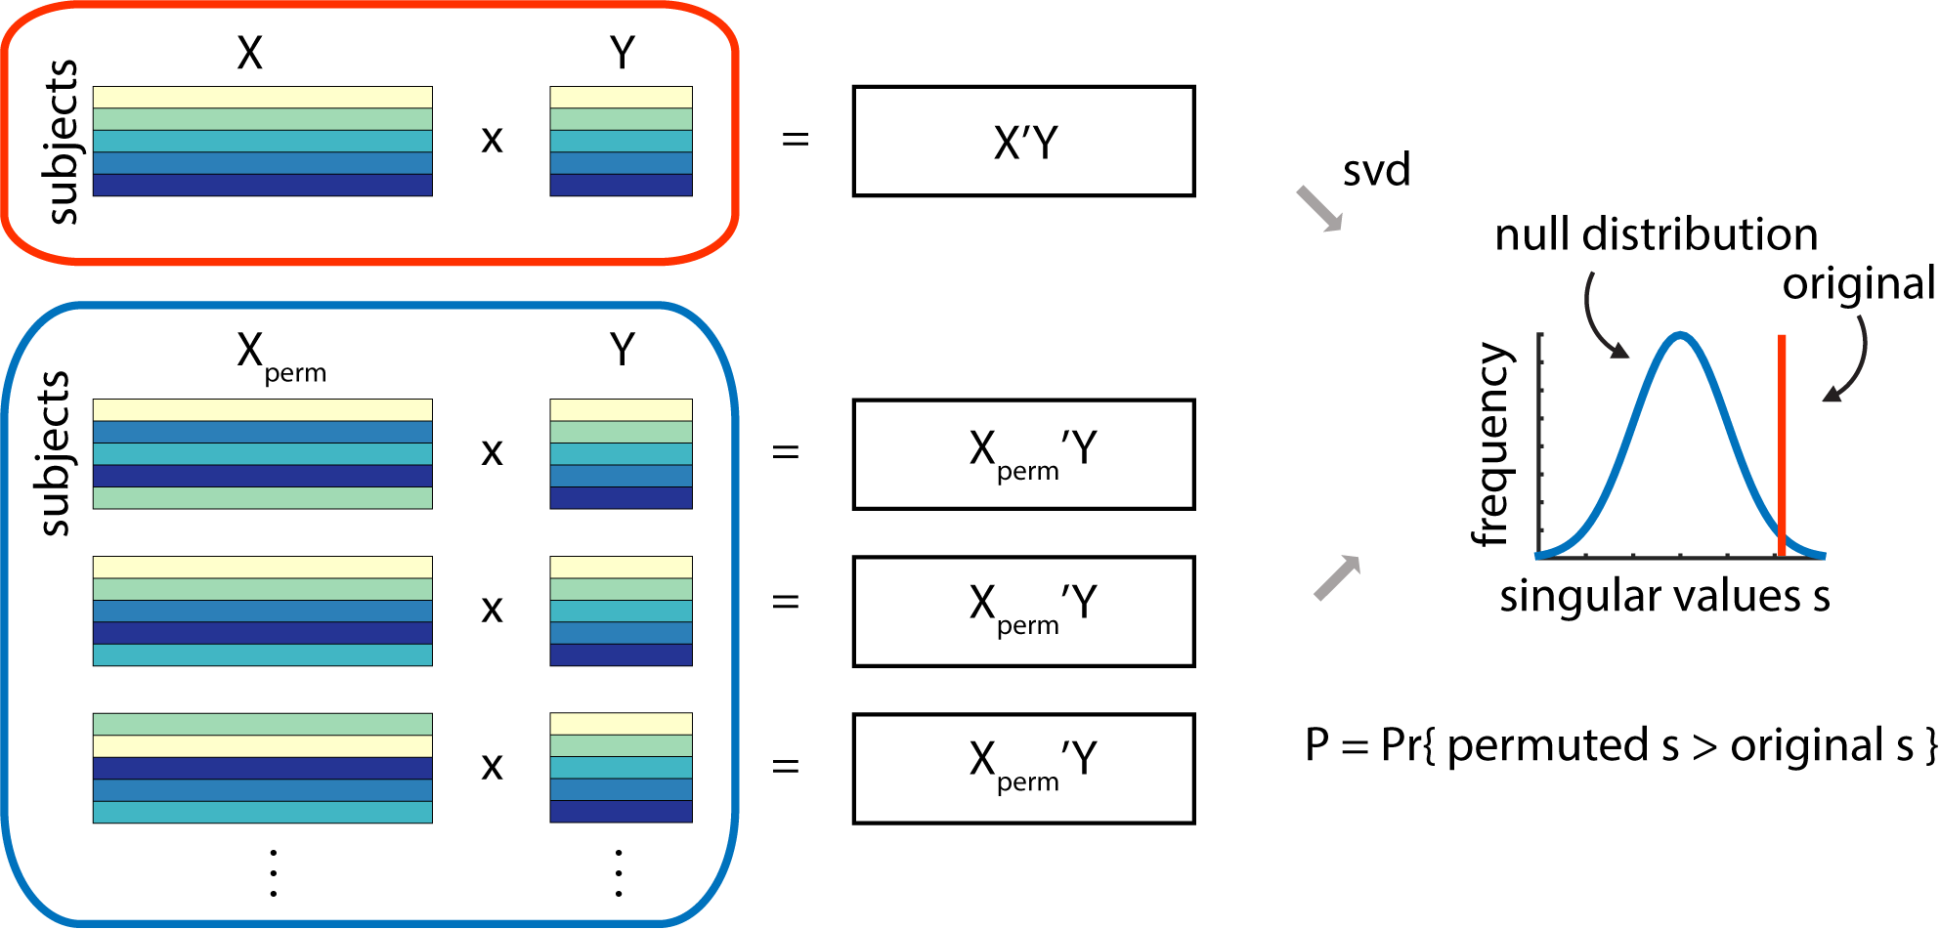
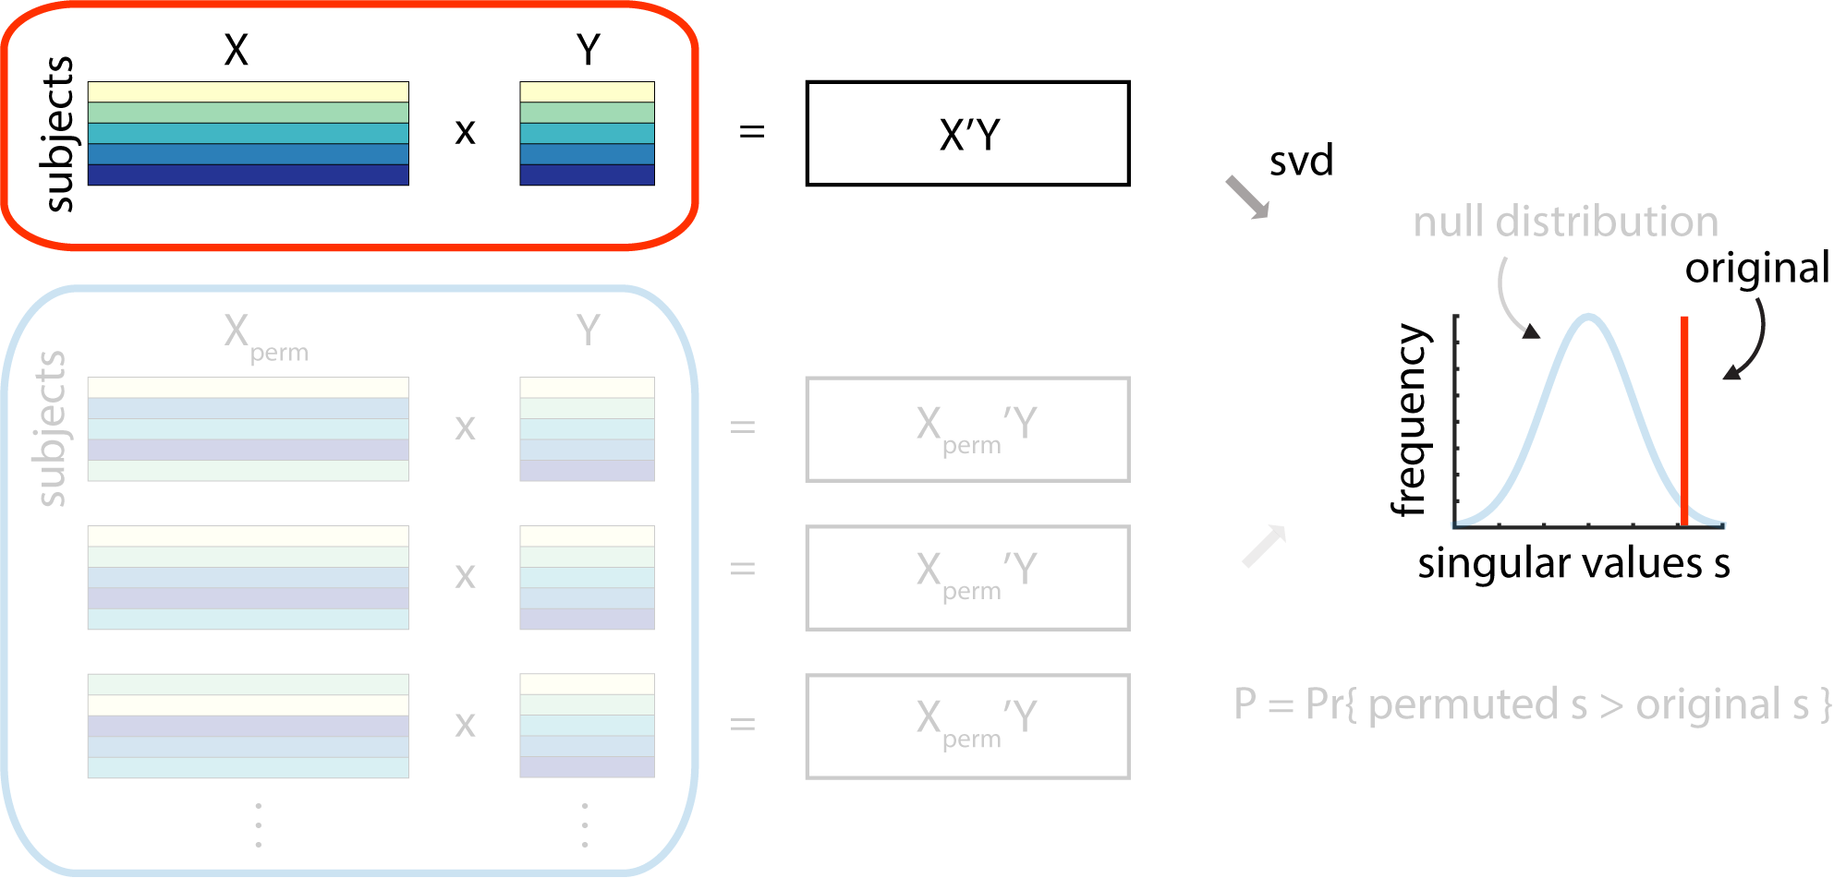
How many components to retain?
Kaiser criterion: drop all eigenvalues lower than 1
“elbow” rule: look for the biggest drop-off in the scree plot
permutation test: which singular values are greater than expected?
Cattell (1966) Mult Behav Res
Thorndike (1953) Psychometrika
Edgington (1965; 1969) J Psychol

Slide 14
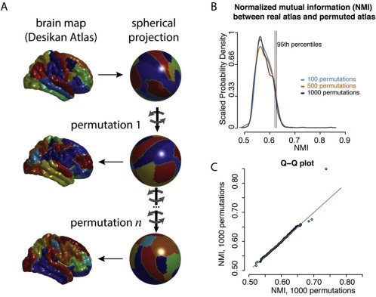
Permutation tests when comparing maps
when comparing topographic maps (i.e. observations = brain regions), simple permutation might not be enough to overcome spatial autocorrelation
examples: comparing gene expression, morphometry, cytoarchitectonics, etc.
can use spherical projection nulls instead (“spin tests”)
Alexander-Bloch et al. (2018) NeuroImage

Slide 15
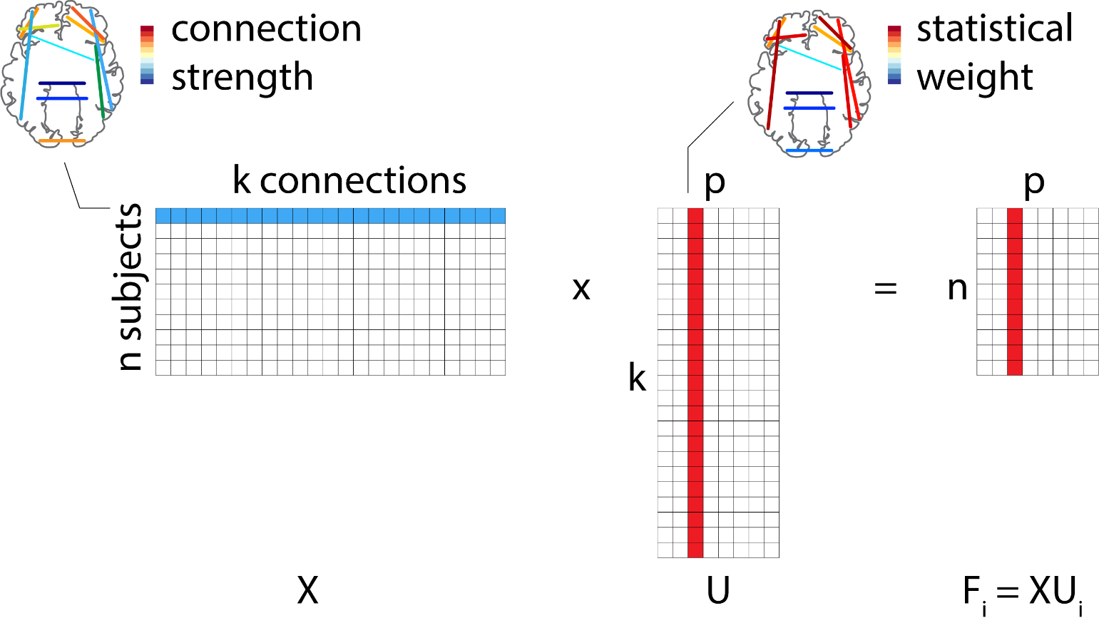
Individual participants
weights that tell us how much each variable (connection, region, behaviour) contributes to the pattern
but every participant is different – how do individual participants express the overall pattern?
participant scores – project original data onto the latent variables

Slide 16
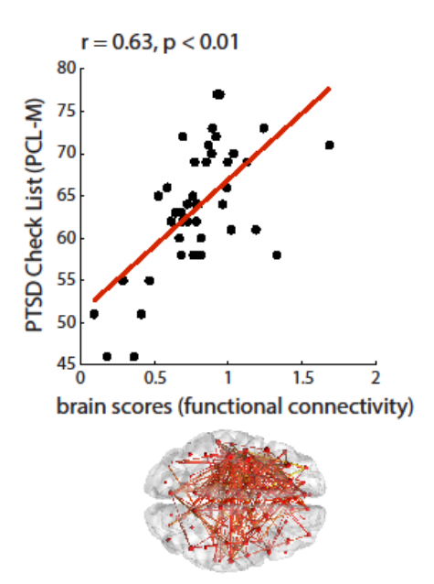
Example: connectivity differences in PTSD and mTBI
Do soldiers with PTSD and mTBI differ in patterns of functional connectivity?
Do individual differences in connectivity relate to symptom severity?
Misic et al. (2016) J Neurosci

Slide 17
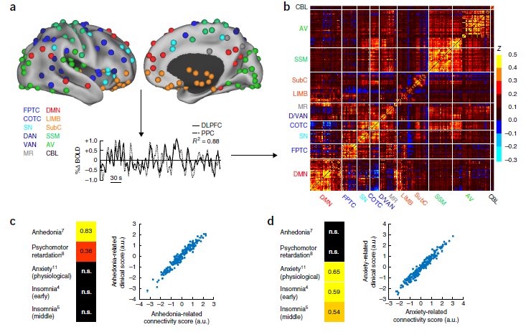

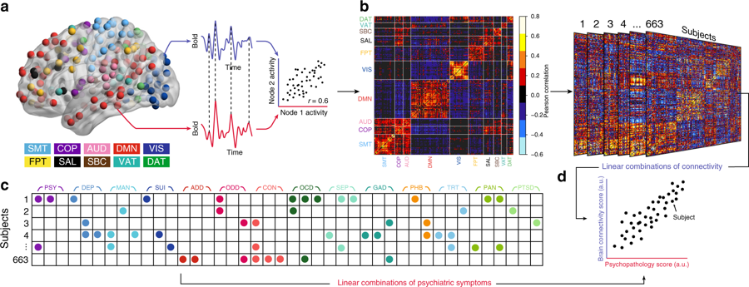
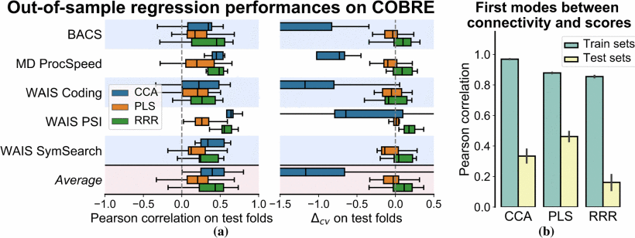
Cross-validation and prediction
the analysis is explicitly trying to maximize correlations between scores
need to cross-validate model:
do scores correlate out-of-sample?
do weights correlate out-of-sample?
can you predict individual variables?
Le Floch et al. (2012) NeuroImage
Kovacevic et al. (2013) New Prespectives Partial Least Squares
Rahim et al. (2017) PRNI

Slide 18
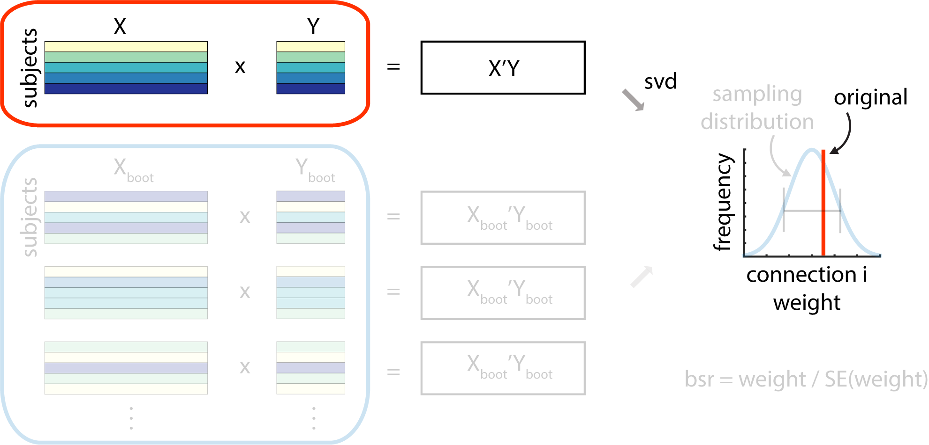
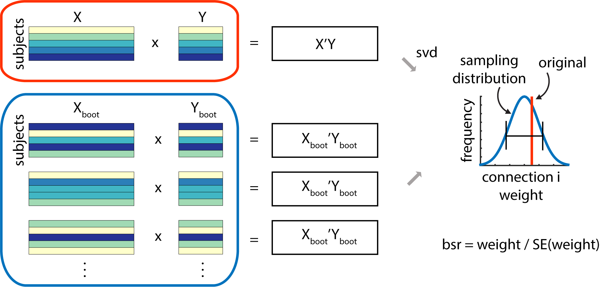
Which variables are important?
singular vector weight: how much should I weigh the variables?
loading: does expression of the original variable correlate with expression of the latent variable?
“bootstrap ratio”: which original variables are weighed highly but also stable across participants?
Efron & Tibshirani (1986) Stat Sci
McIntosh et al. (1996) NeuroImage

Slide 19
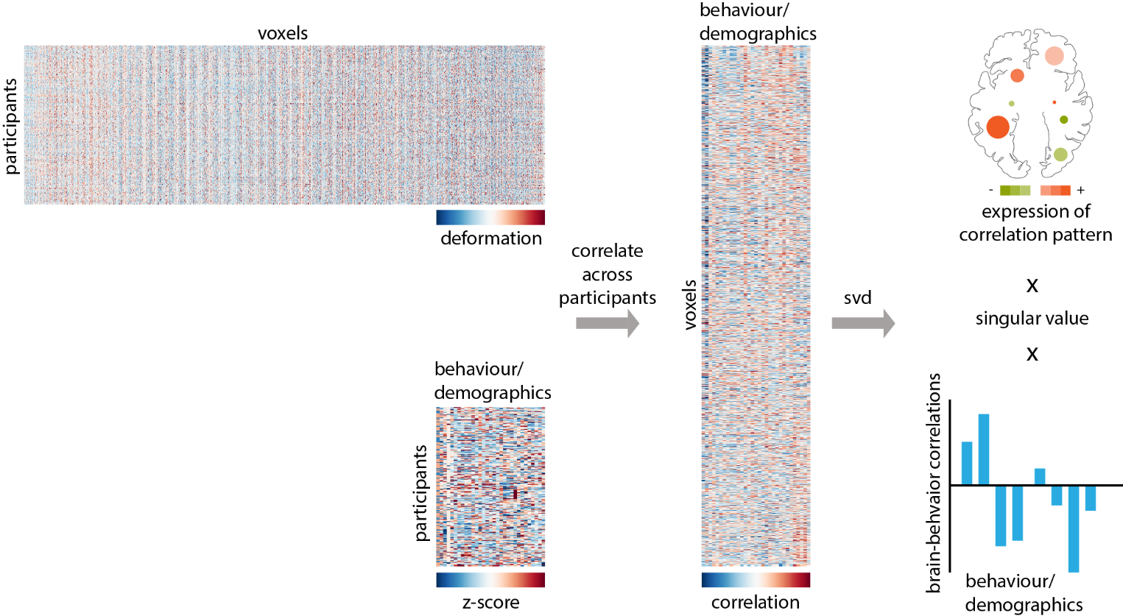
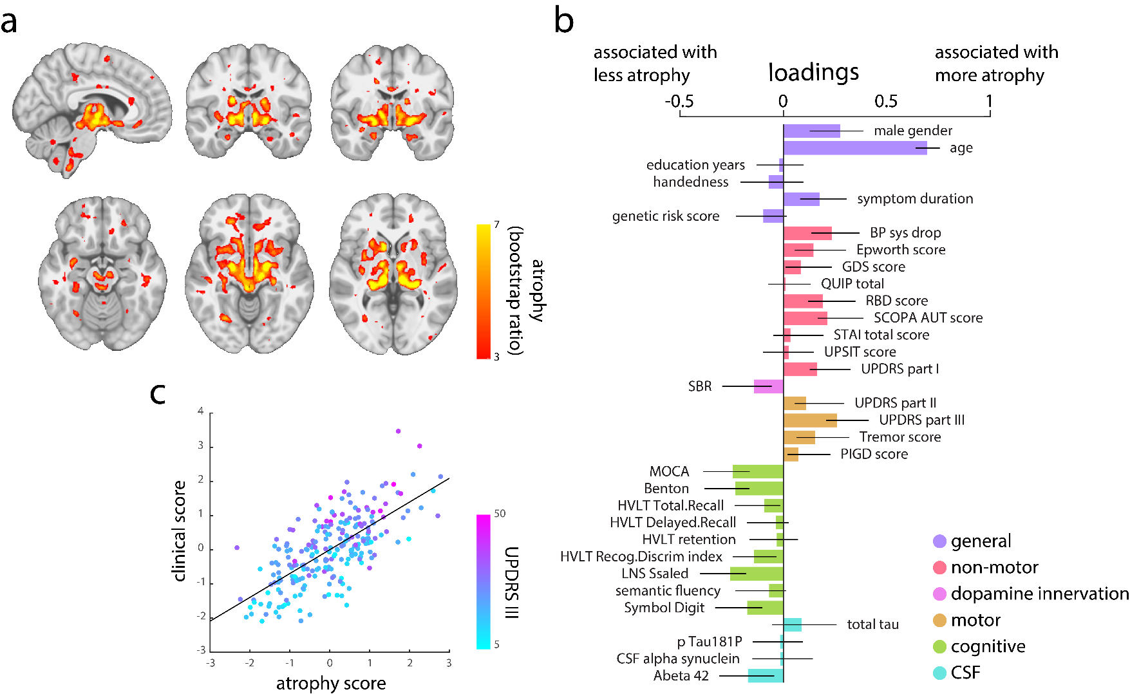
Example: clinical-anatomical signature of Parkinson’s disease
brain (a): show bootstrap ratios, threshold at 99% confidence interval
behaviour (b): show loadings with bootstrap-estimated confidence intervals
scores (c): correlated either with each other, or with another variable
Zeighami et al. (2018) NeuroImage

Slide 20
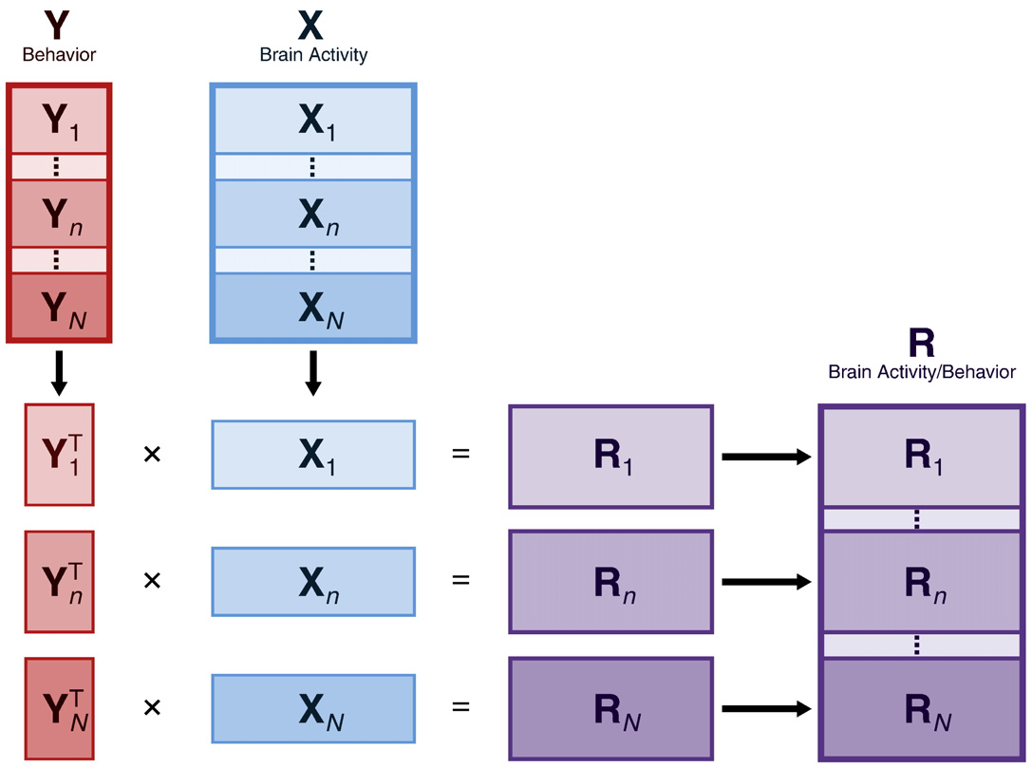
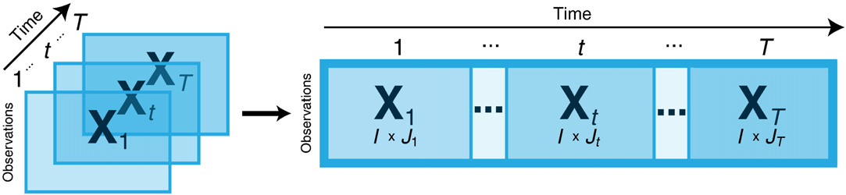
Adding dimensions
concatenate dimensions (e.g. time + space)
concatenate within- and between-subject manipulations (e.g. conditions and groups)
Krishnan et al. (2011) NeuroImage

Slide 21
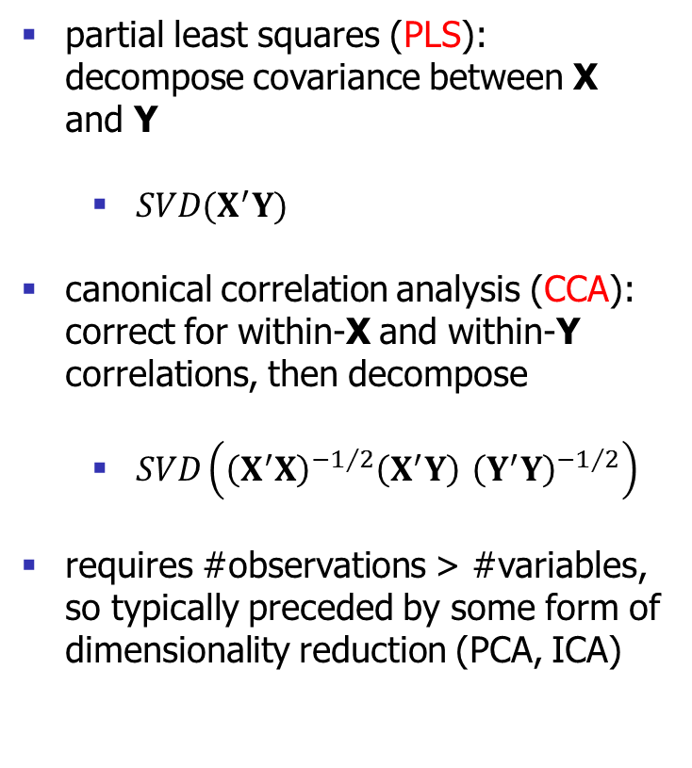
Canonical Correlation Analysis (CCA)
partial least squares (PLS): decompose covariance between X and Y
$SVD(X^{′}Y)$
canonical correlation analysis (CCA): correct for within-X and within-Y correlations, then decompose
$SVD\left({\left(X^{′}X\right)}^{−1/2}{\left(X^{′}Y\right) \left(Y^{′}Y\right)}^{−1/2}\right)$
requires #observations > #variables, so typically preceded by some form of dimensionality reduction (PCA, ICA)
Hotelling et al. (1936) Biometrika

Slide 22
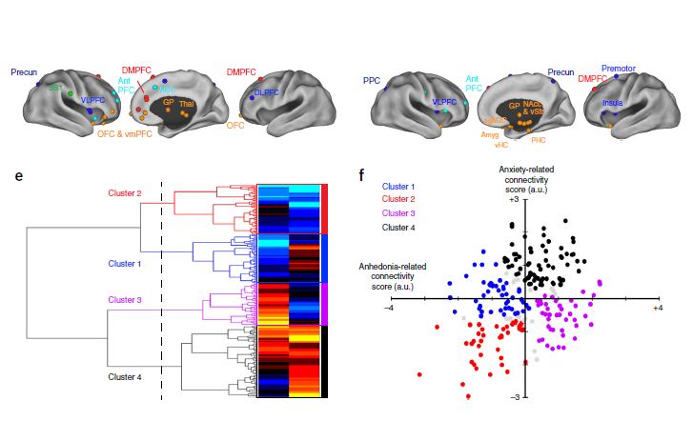
Example #1: connectivity- and behaviour-defined biotypes of depression
X = functional connectivity, Y = behaviour
Use CCA to reduce dimensionality, then cluster
Drysdale et al. (2016) Nat Med
see also: Dinga et al. (2018) bioRxiv

Slide 23
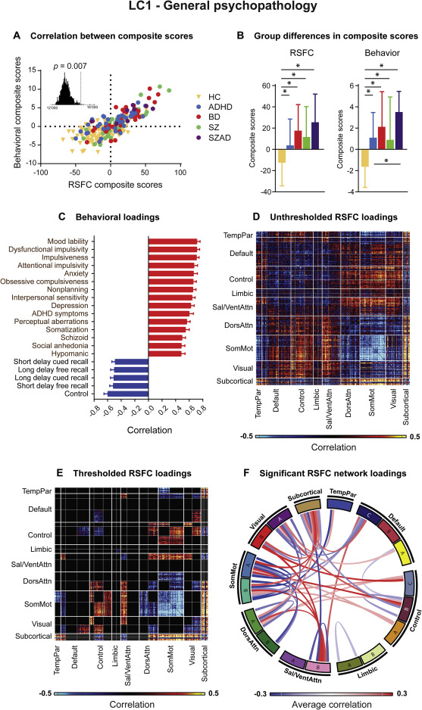
Example #2: transdiagnostic signatures of affective disorders
X = functional connectivity, Y = behaviour
UCLA phenomics consortium:
ADHD
Bipolar
Schizophrenia
Schizoaffective
Kebets et al. (2019) Biol Psychiat
see also: Xia et al. (2017) Nat Commun

Slide 24
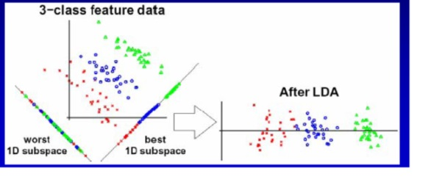
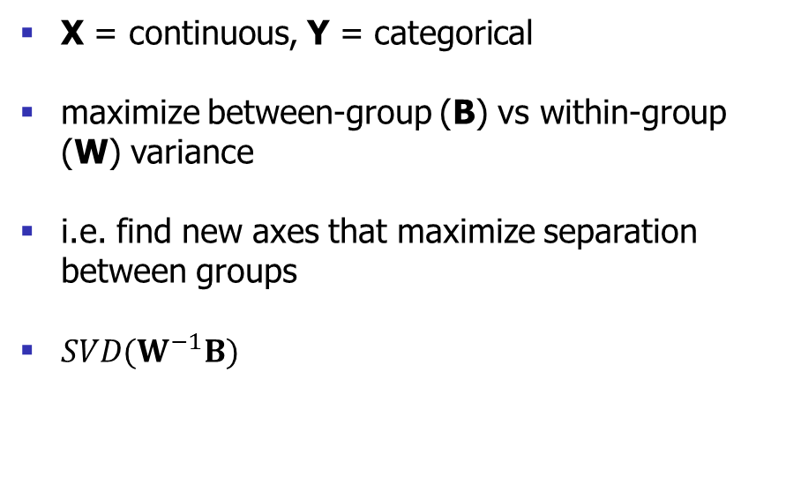
Linear Discriminant Analysis (LDA)
X = continuous, Y = categorical
maximize between-group (B) vs within-group (W) variance
i.e. find new axes that maximize separation between groups
$SVD(W^{−1}B)$
https://mlalgorithm.wordpress.com

Slide 25
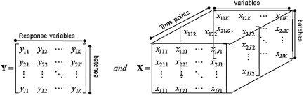
Extensions
sparse/regularized solutions, e.g. sCCA: Witten & Tibshirani (2009) Stat Appl Genet Mol Biol MSNR: Xia et al. (2019) bioRxiv
3+ datasets, e.g. PARAFAC: Bro (1997) Chemometr Intell Lab Multiway PLS: Wold et al. (1987) J Chemometrics
nonlinear dependencies
bayesian implementations, e.g. IBFA: Virtanen et al. (2011) ICML-II

Slide 26
Summary
Multivariate models embody the network property
Many linear multivariate models are related, but entail unique assumptions
Multivariate models are versatile and complementary to other statistical models

Slide 27

Demo: myConnectome
Deep phenotyping in a single individual
X = rs-fMRI functional connectivity
Y = subjective mood (PANAS-X)
N = 73 sessions
Question: are connectivity and mood related?

